Slide 1
A Tale of Six Synchrotrons
May Sharpe
MXCuBE-ISPyB meeting, Diamond Light Source, 18 November 2025

Slide 2
Contents
SLS Fragment Screening Platform
The Dark Period
Finding Light Elsewhere
A Better Way?

Slide 3
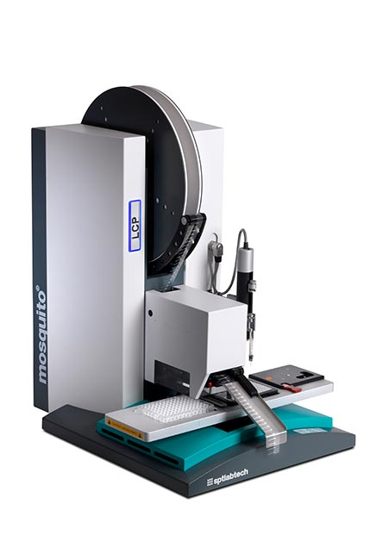
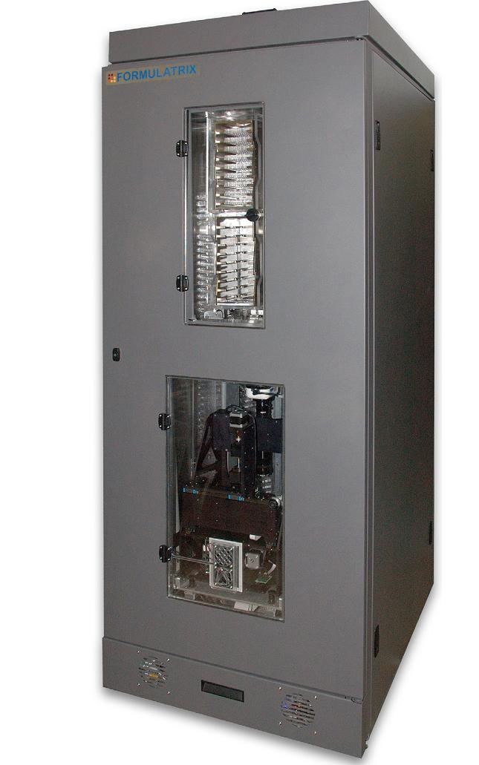
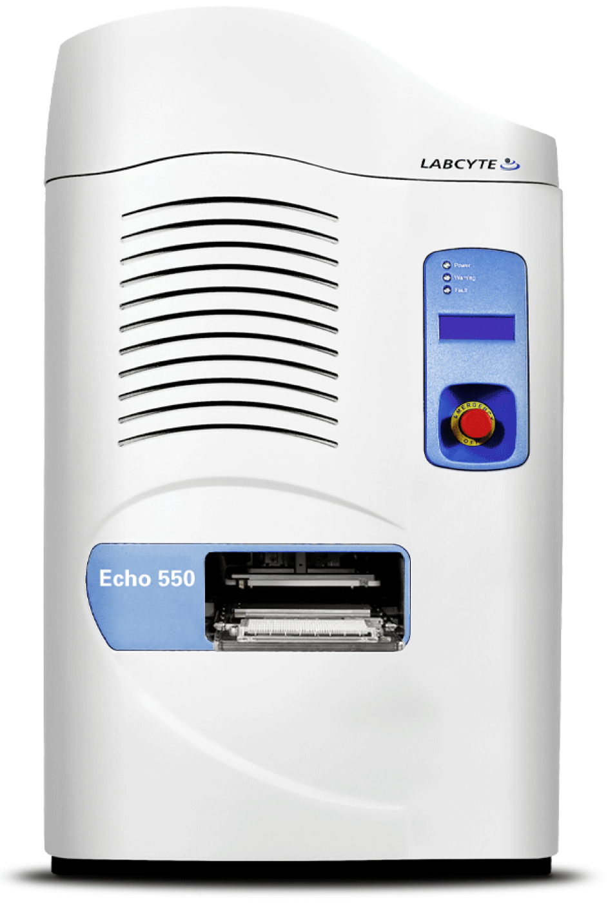
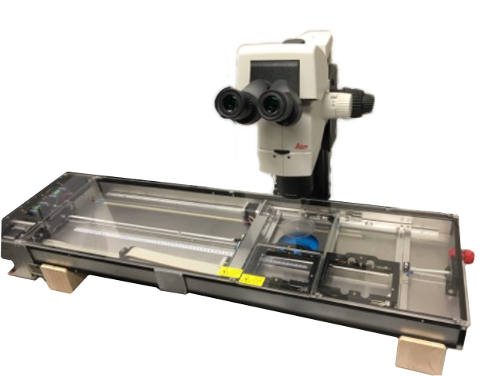
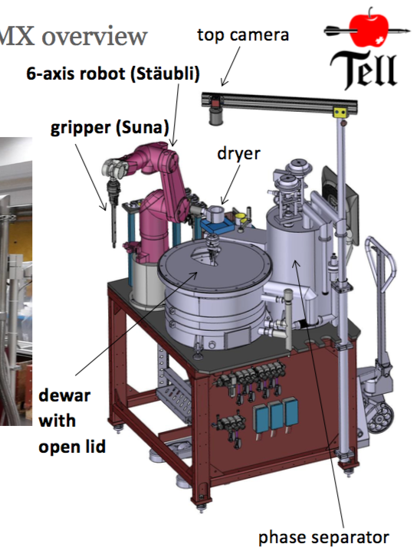
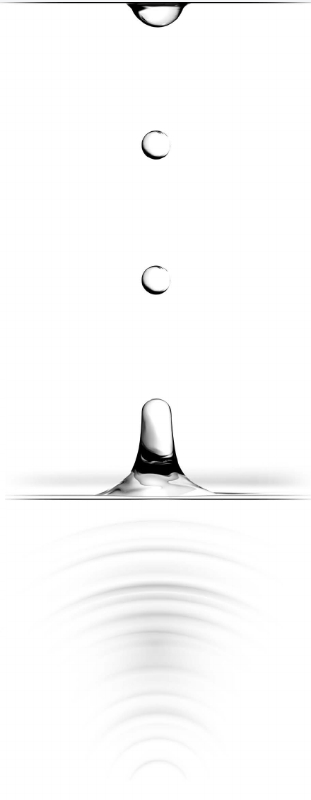

Fast Fragment and Compound Screening (FFCS) Pipeline
In operation since 2019
Service and collaborative academic projects
In-house software: FFCS Database (mongoDB) + GUI (PyQt5)
Non-relational database as fragment campaign hub
Generates input files and collects output files for all devices
Organises crystal plates, cryo protection, soaking and fishing
Sharpe et al, Nippon Kessho Gakkai-Shi (2021) 63(3) 232; Kaminski et al., (2022). Acta Cryst. D78, 328-336
Stegmann, et al., Methods in Enzymology, vol. 690, pp. 235–284.
Crystal Growth
Soaking
Harvesting
Sample Delivery
Data Collection
Data Processing +Refinement
Structures!

Slide 4

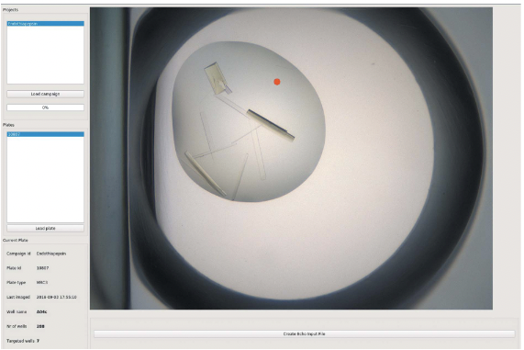

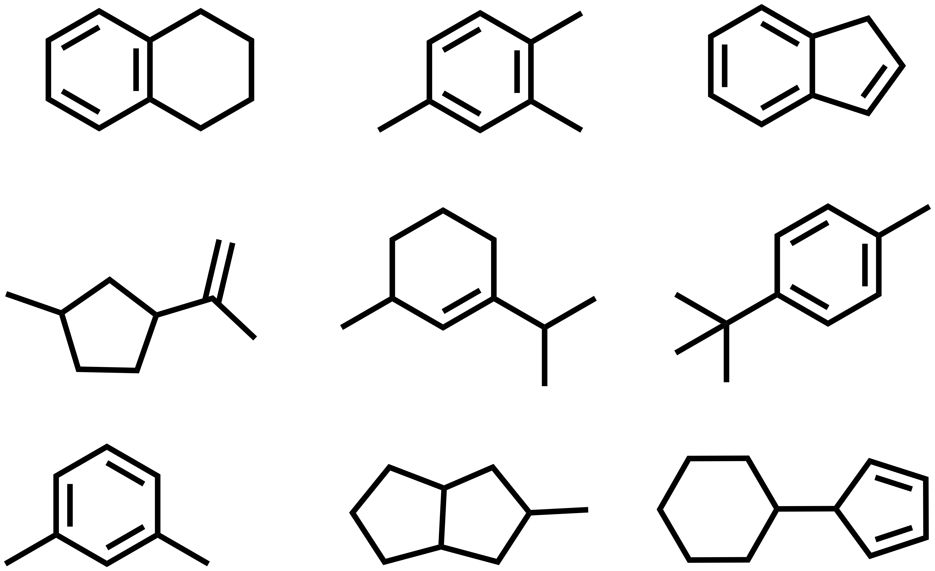
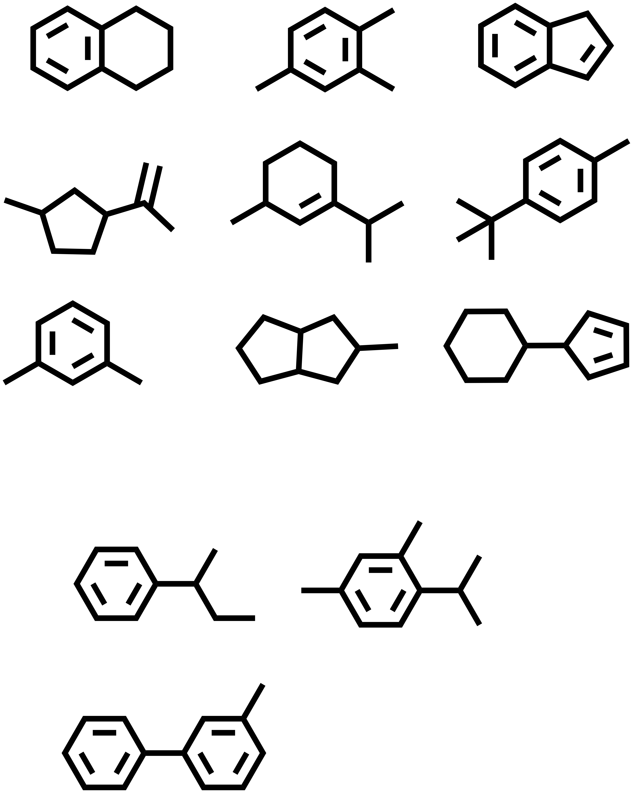
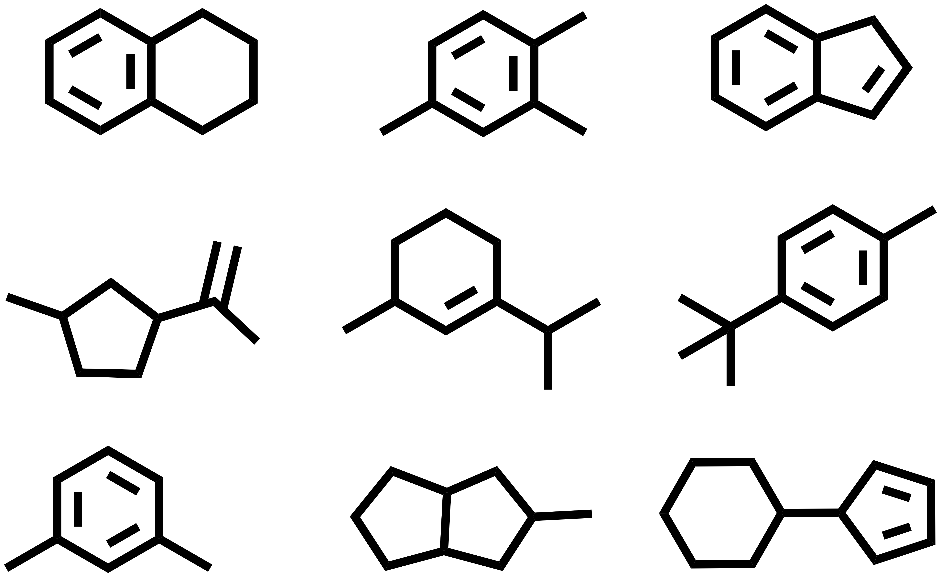

The FFCS Software
Virtualize experiments
object in database
crystal plate
Offset targeting
crystal
offset X-Y- coordinates
selected target coordinates
Combine ligands & crystals
FFCS DB Server
…
dispensing protocol
XY- coordinates
selected fragments
harvesting protocol
Soaking experiments
dispensing protocol
harvesting protocol
dispensing results
fishing results
fishing results
Echo
Metz, Stegmann et al., Acta Cryst. D, 2024.
results file

Slide 5
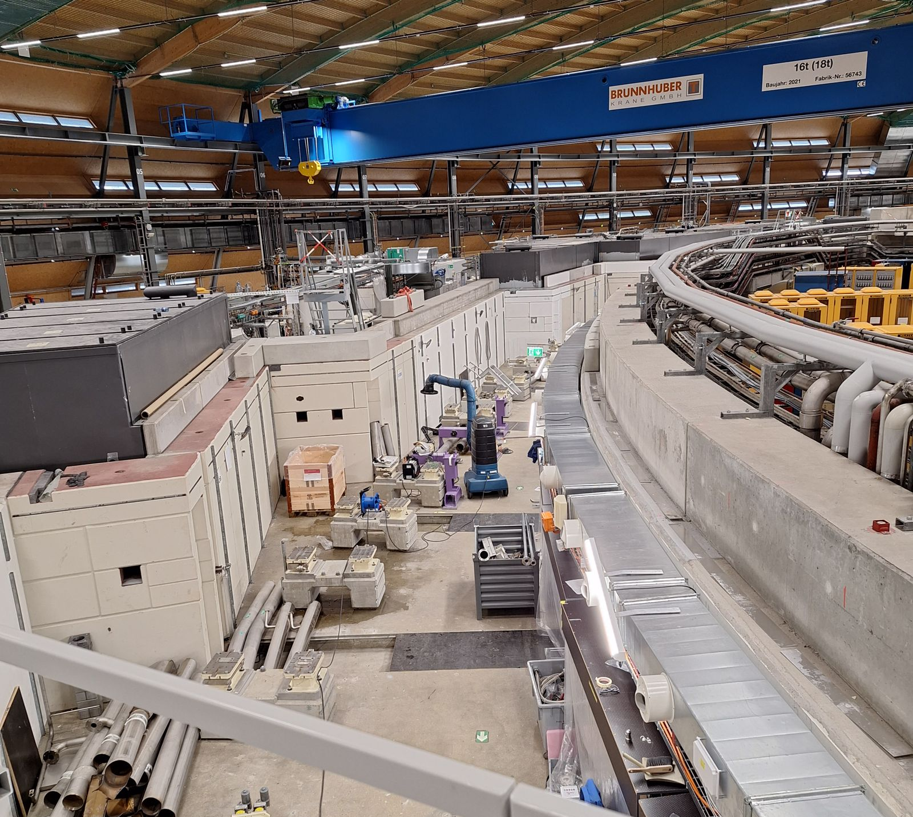
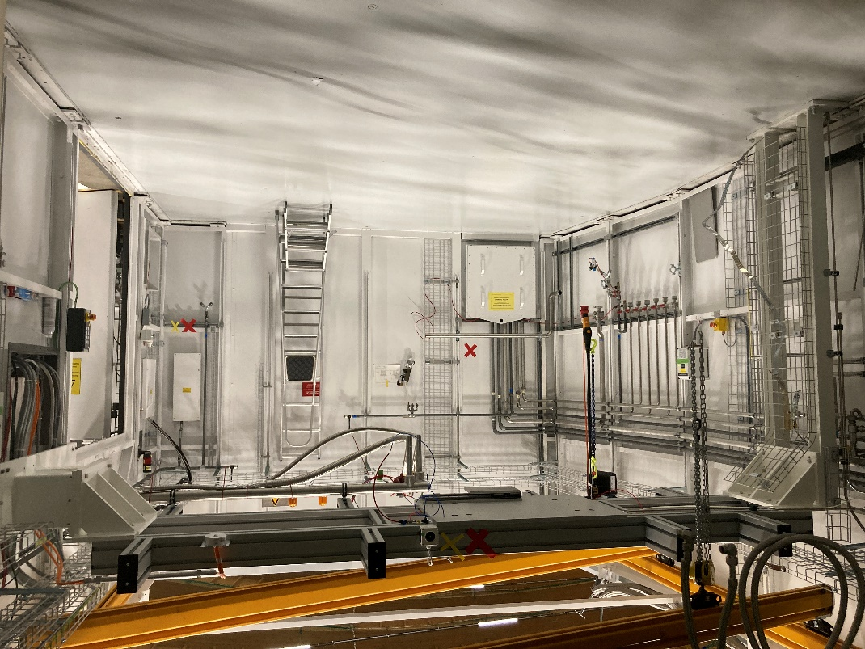
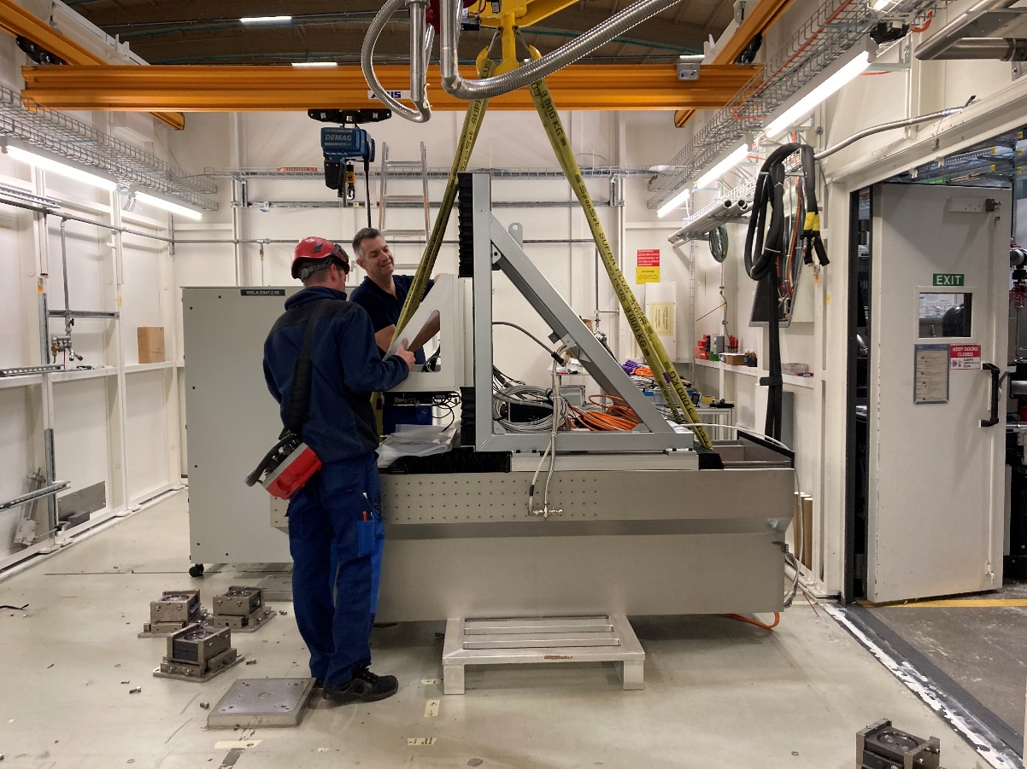
The Dark Time
From October 2023…
PXII
PXI
Storage Ring

Slide 6





Seeking Light Elsewhere
A multiplicity of external synchrotrons
Collected data from as many different beamlines as we could
An illuminating experience! But made life hard for ourselves…
Organizing shipments
Uploading sample data and location
Diffraction Plans (optional)
Data Transfer from Synchrotron

Slide 7
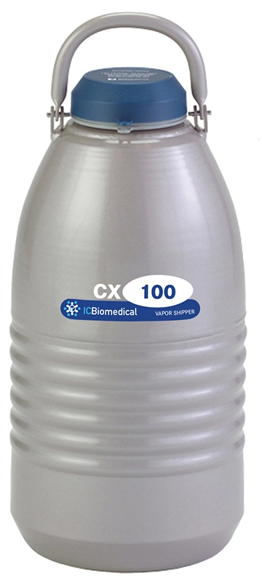
Data Flow: FFCS Database to Synchrotron
Dewar Information
Plate Class
Wells Class
Processing Class
_id: ObjectId
userAccount: str
plateId: str
campaignId: str
plateType: str
dropVolume: int
batchId: str
createdOn: datetime
lastImaged: datetime
soakExportTime: datetime
soakTransferTime: datetime
cryoProtection: bool
….
_id: ObjectId
userAccount: str
campaignId: str
plateId: str
well: str
libraryId: str
smiles: str
compoundCode: str
libraryConcentration: int
puckBarcode: str
puckPosition: str
puckType: Literal["spinepuck", "unipuck"]
xtalName: str
….
_id: ObjectId
userAccount: str
campaignId: str
xtalName: str
xtalAlias: str
imageName: str
imagesLocation: str
runNumber: str
datasetId: str
outputDirectory: str
refDataset: str
refModel: str
rawdataDirectory: str
processingDirectory: str
synchrotronSource: str
h5_metadata: H5Metadata
autoproc: dict[str, AutoProc]
dimple: dict[str, Dimple]
….
Synchrotron
Library Class
_id: ObjectId
libraryBarcode: str
libraryName: str
fragments: list[Fragment]
userAccount: str
campaignId: str
Diffraction Plan
Sample Information

Slide 8
Data Flow: Synchrotron to FFCS Database
_id: ObjectId
userAccount: str
campaignId: str
xtalName: str
xtalAlias: str
imageName: str
imagesLocation: str
runNumber: str
datasetId: str
outputDirectory: str
refDataset: str
refModel: str
rawdataDirectory: str
processingDirectory: str
synchrotronSource: str
h5_metadata: H5Metadata
autoproc: dict[str, AutoProc]
dimple: dict[str, Dimple]
….
Image Transfer
PSI Ra Cluster
Datasets ingested based on name of image files (alias file), and then matched with XtalName in the FFCS DB, so data can be linked
Data Processing Pipeline:
Autoproc
Dimple
Phenix
Refmac
Buster
Pipedream
Pandda

Slide 9

Can We Envision Another Way?
Diverse sample transfer workflows between synchrotrons
Could the data that needs to be transferred be unified?
Minimal model: Crystal ID, crystal location + Diffraction plan
Post data collection: standardised format for data collection information?
Initial tests:
Added a function to export data from the FFCS DB into MXLIMS JSON format
Use the previous MAXIV shipment
Programmatically transfer data from MXLIMS into EXI

Slide 10
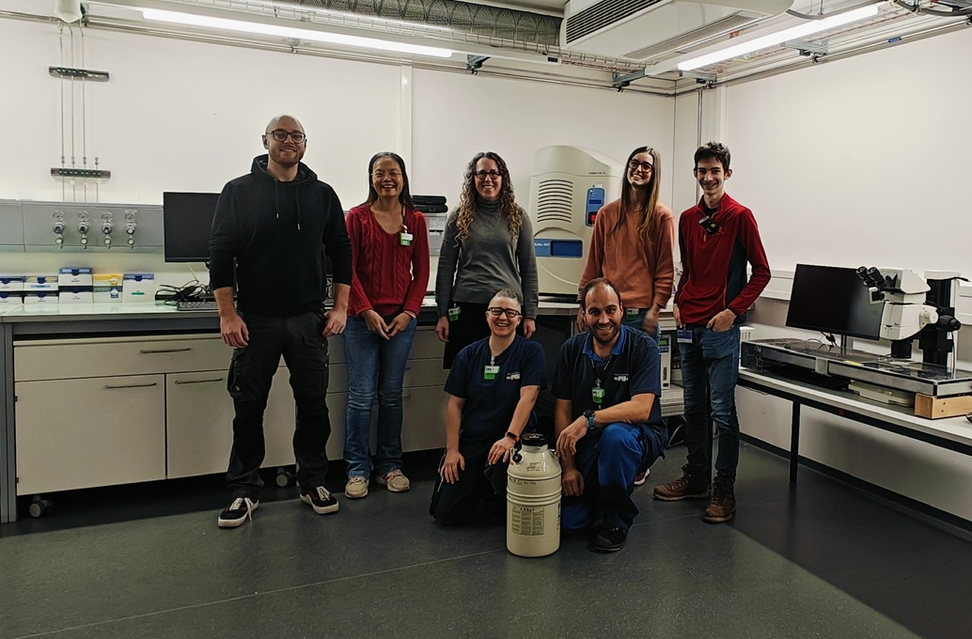
Acknowledgements
Dennis Stegmann
Sonia Reber
Eric Plichta
Kate Smith (Australian Light Source)
Zac Panepucci (MAXIV)
Gérard Bricogne
Rasmus Fogh
Ed Daniels

